Slide 1
The Sputtering 1970s
Economic Policies under
Nixon, Ford, and Carter

Slide 2
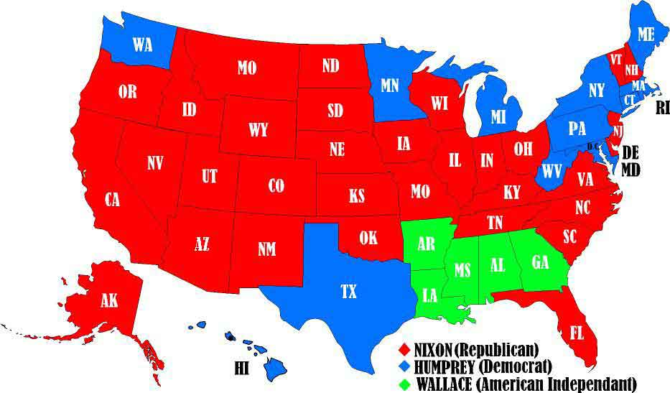
Election of 1968
Popular Vote 32 million to 31 million to 10 million

Slide 3
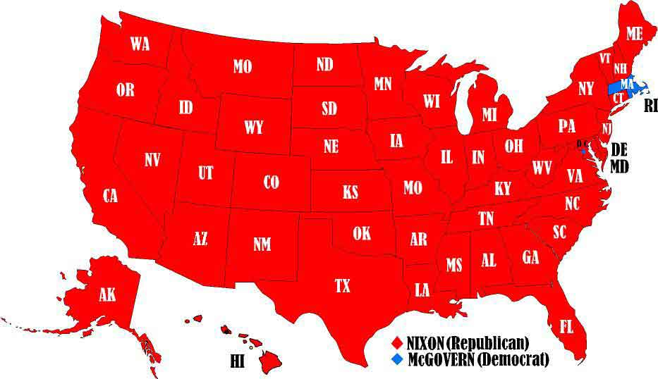
Election of 1972
Popular vote 47 million to 29 million

Slide 4
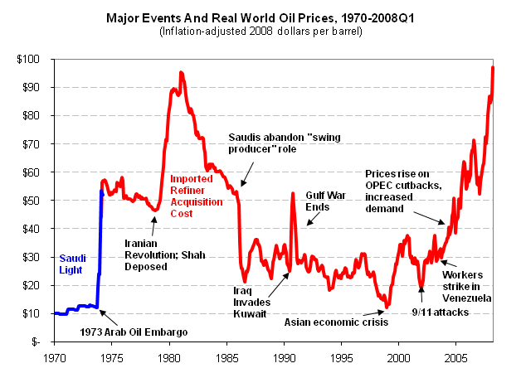
The Oil Shock

Slide 5
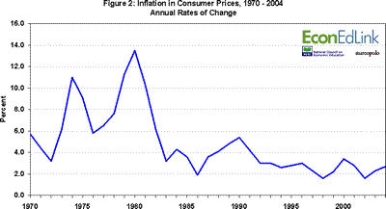
Inflation Rates

Slide 6
Inflation
Led largely by oil prices, inflation skyrockets.
Why can oil do this to the economy?

Slide 7
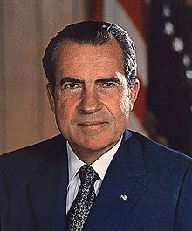
Nixon’s Economic Policies
Cut government spending
Instituted wage and price controls

Slide 8
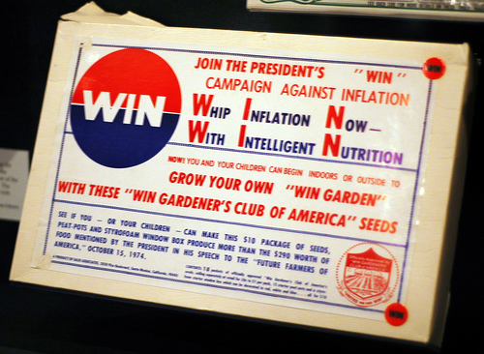
Gerald Ford
WIN (Whip Inflation Now) did not stop Ford from losing.
Was a propaganda / voluntary campaign.

Slide 9
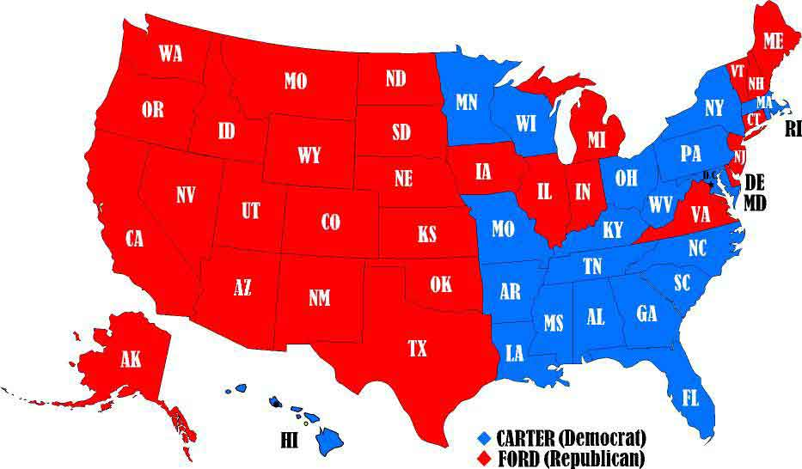
Election of 1976
41 million to 39 million

Slide 10
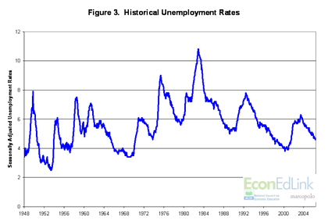
Unemployment

Slide 11
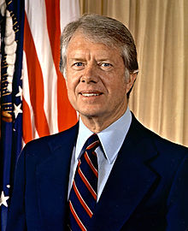
Carter’s Plan
Solve “high” unemployment by allowing inflation to rise.

Slide 12
Stagflation
Turns out that unemployment and inflation are not actually an either or proposition.

Slide 13
Misery Index
http://www.miseryindex.us/indexbyyear.aspx
President Time Period Start End Change Average
Lyndon B Johnson 1963-11 - 1968-12 7.02 8.12 1.10 6.77
Richard M Nixon 1969-01 - 1974-07 7.80 17.01 9.21 10.57
Gerald R Ford 1974-08 - 1976-12 16.36 12.66 -3.70 16.00
James E Carter, Jr. 1977-01 - 1980-12 12.72 19.72 7.00 16.26
Ronald W Reagan 1981-01 - 1988-12 19.33 9.72 -9.61 12.19
Barack H Obama 2009-01 - 2013-03 7.83 9.07 1.24 10.54

Slide 14
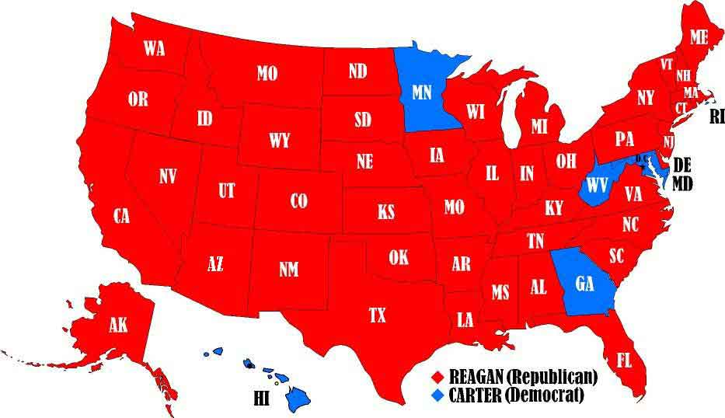
Election of 1980
44 million to 35 million

