Slide 1
Reconstructing the Reconstruction

Slide 2
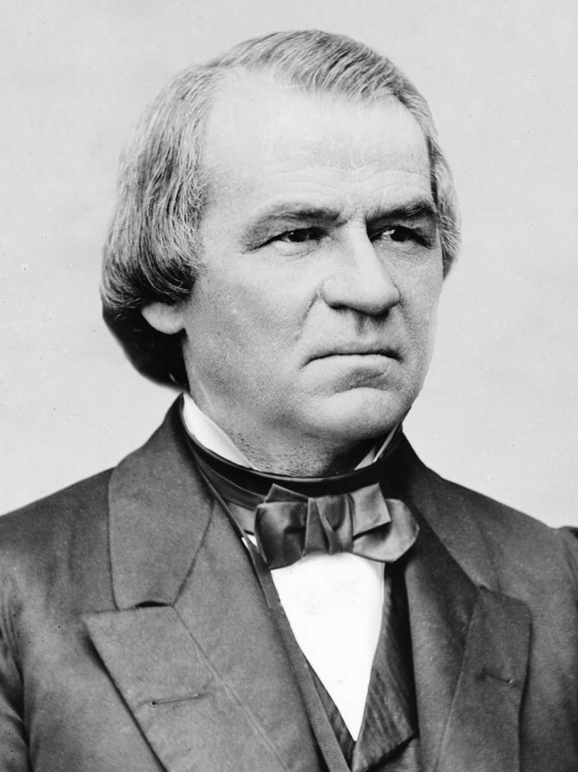
Andrew Johnson
Only Southern Senator
to remain loyal in Civil
War.
Proposed lenient policy
Toward South which
Predominated 1865-1867.
“Presidential Reconstruction”

Slide 3
Presidential Reconstruction
Andrew Johnson believed the South could continue to rule itself.
Pardoned most Southern Whites, appointed provisional governors, sets up new state governments.
Believed South should decide how to treat blacks in its own territory.

Slide 4
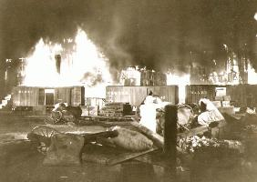
Goals of Reconstruction
South’s road to reintroduction into Union.
How to treat former slaves.
Perhaps punish the South.
The burning of Atlanta was not enough revenge for some Union supporters

Slide 5
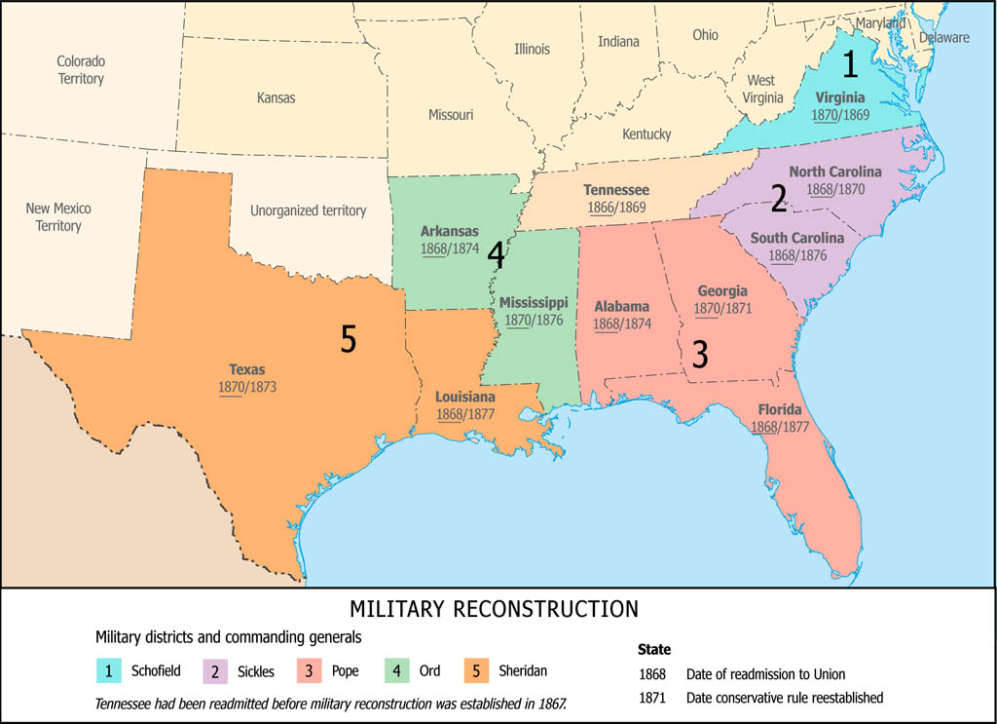
Radical Republicans
Swept to power in 1866.
Military Reconstruction Act of 1867.
South becomes 5 military districts.
Blacks integrated.

Slide 6
Impeaching Andrew Johnson
House and Senate both heavily Republican.
House of Representatives votes to impeach.
Vote in Senate 35 to 19 to convict, one too few.
Seven Republicans crossed party lines.

Slide 7
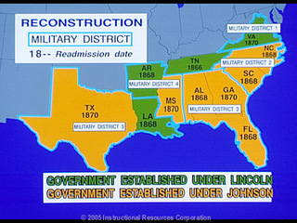
Readmitting the South

Slide 8
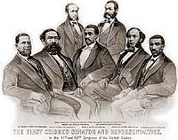
Short-Lived African-American Gains
Seven Black southern congressmen elected.
One governor.

Slide 9
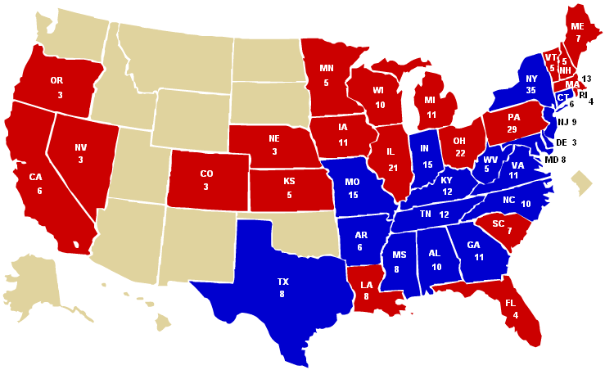
Election of 1876
Without doing the math or looking it up, do you think the Democrat or the Republican won?

Slide 10
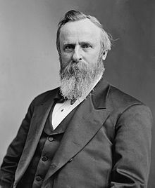
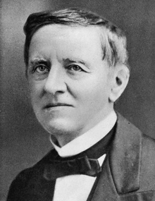
Results of Election of 1876
Hayes (R) wins 185 electoral votes,
4,036,298 popular votes.
Tilden (D) wins 184 electoral votes
4,300,590 popular votes.
Alleged compromise of 1877.
Hayes
Tilden (Gov. of New York 1875-1876)

Slide 11
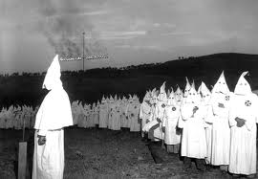
Withdrawal of Union Troops
Union troops were drawn back in 1877.
Gave the coercive advantage to white supremacy groups
Ku Klux Klan
Knights of the White Camila
White Brotherhood.

Slide 12
Selected Photo Credits
270towin.com
iphotocentral.com
wikipedia.com
ushistory.org

