Slide 1
Latin through History
From Roman Times Until Today

Slide 2
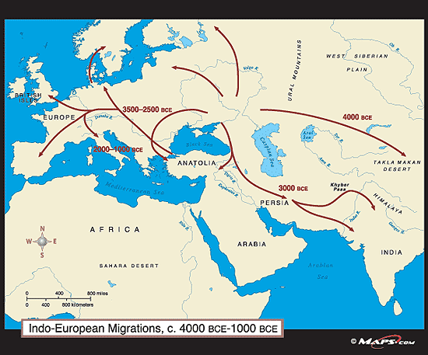
Indo-European Languages
www.public.iastate.edu

Slide 3
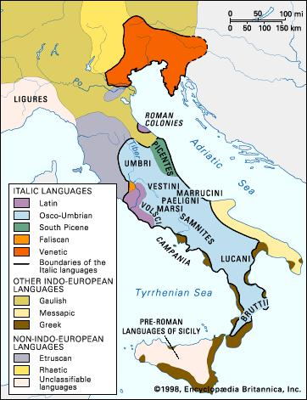
Circa 250 BC, Pre-Expansion Latin
Encyclopedia Brittanica

Slide 4
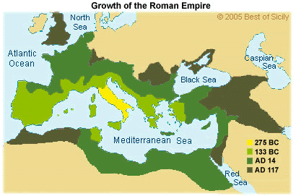
Growth of the Roman Empire
BestofSicily.com

Slide 5
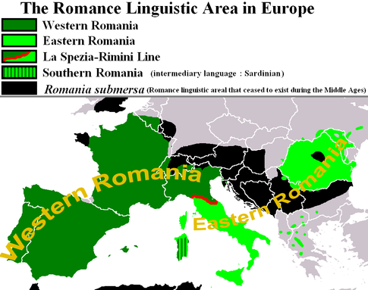
Extent of Latin
Circa 400 AD
www.quora.com

Slide 6
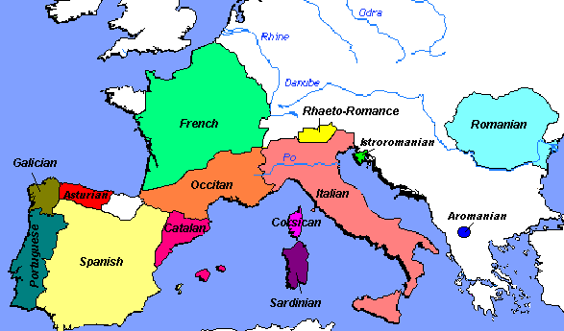
Romance Languages in Europe
tied.verbix.com

Slide 7
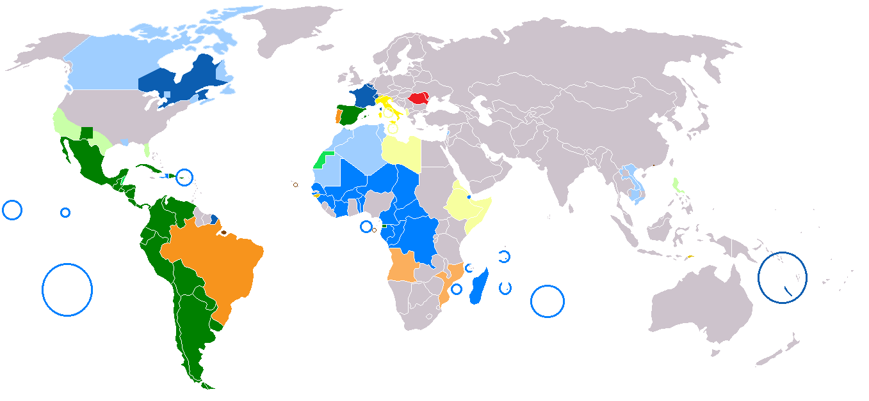
Romance Language Worldwide
commons.wikimedia.org

Slide 8
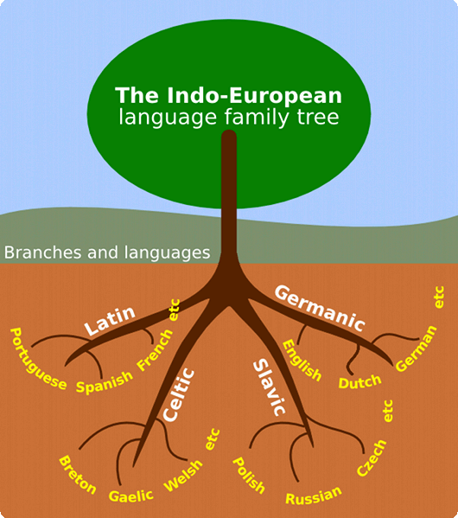
Indo-European
Languages
pibmirim.socioambiental.org

Slide 9
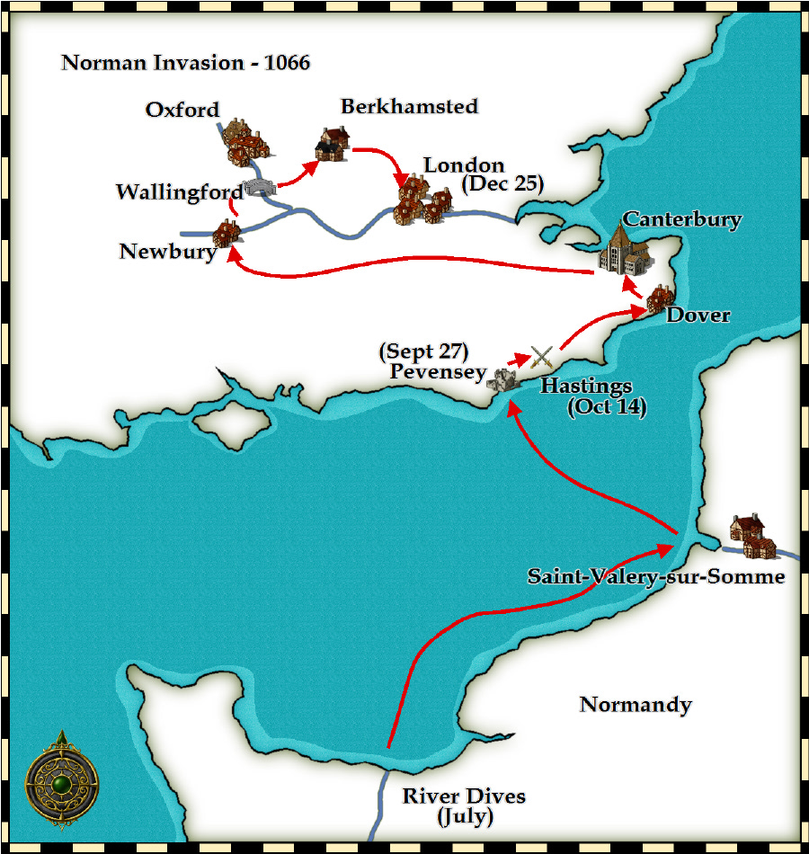
Norman Invasion 1066
pantherfile.uwm.edu

Slide 10
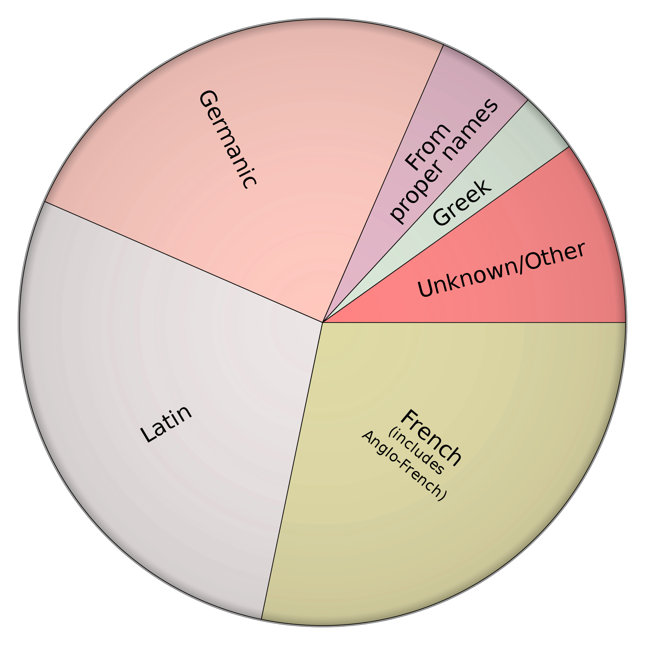
wikipedia.com

Slide 11
Give as Many Derivatives as you can
discipulus: student
scriptum: written
littera: letter (like “a, b, c…”)
numerus: number
verto: turn

